Slide 1
Summer Academy
© 2023 Teach For America, Inc. All rights reserved. Distribution or any reproduction is strictly prohibited. For more information, contact Teach For America.
Notes:
If you’d like to access the deck template to add new slides, locate the Pre-Service 2023 deck template here.

Slide 2
Summer Academy Purpose
Summer Academy is as a co-created summer experience between Payette School District and TFA Idaho offering students additional quality learning hours, exploration of their futures and fosters a community of growth and development for novice teachers, mentors, summer school staff, and students.

Slide 3
Summer Academy Purpose
Summer Academy is as a co-created summer experience between Payette School District and TFA Idaho offering students additional quality learning hours, exploration of their futures and fosters a community of growth and development for novice teachers, mentors, summer school staff, and students.
Additional Quality Learning Hours:
120 students will receive an additional 60 hours of quality learning hours by participating in Summer Academy
Courses will use the National Summer School Initiative curriculum designed for accelerated learning that will support students to thrive in the next grade-level

Slide 4
Summer Academy Purpose
Summer Academy is as a co-created summer experience between Payette School District and TFA Idaho offering students additional quality learning hours, exploration of their futures and fosters a community of growth and development for novice teachers, mentors, summer school staff, and students.
Exploration of Students Futures:
Learning experiences are aligned with and useful for students futures
Project based learning design will be focused on students ability to explore their futures and/or career interests
Subgroup of students participating in “Future Shock” where students will be able to identify unique strengths, skillsets, and interests to support them identifying interests and relevant fields/careers to explore.

Slide 5
Summer Academy Purpose
Summer Academy is as a co-created summer experience between Payette School District and TFA Idaho offering students additional quality learning hours, exploration of their futures and fosters a community of growth and development for novice teachers, mentors, summer school staff, and students.
Community of growth and development
Daily morning meetings to align and facilitate school day
Ecosystems of support for novice teacher with assigned Mentor and Teacher Coach
Mentor and Teacher Coach partnership to align and direct development of teacher
Community practice of feedback

Slide 6
Summer Academy Outcomes
Success Criterias
Students | Corps members | Mentor teachers/Coaches
80% mastery of content as measured by pre-/post-test | 100% retention as measured by enrollment records | 80% agree or strongly agree that the experience helped them better lead adults
90% attendance as measured by attendance records | 100% attendance as measured by attendance records | 100% attendance as measured by attendance records
80% agree or strongly agree the experience was worthwhile as measured by survey | 90% agree or strongly agree the experience was worthwhile as measured by survey | 80% agree or strongly agree that they would recommend leading adults during summer school
80% agree or strongly agree confidence in academic ability and relevance of summer academy for their futures | 80% agree or strongly agree the experience prepared them for their first weeks of leading their own classrooms. | 80% agree or strongly agree that they grew in their ability to support novice teachers development
Students agree that engaging in a project based learning experience supported their ability to explore their futures, career interests, and excitement for participating. | CMs agree to the ability to build strong authentic relationships with students and facilitate meaningful learning experiences that are aligned with and useful for students' futures. | Mentors agree that they developed the skill of implementing project-based learning experiences that are aligned with and useful for students' futures.

Slide 7
Data Measuring Outcomes
Success Criterias
Students | Corps members | Mentor teachers/Coaches
80% mastery of content as measured by pre-/post-test | 100% retention as measured by enrollment records | 80% agree or strongly agree that the experience helped them better lead adults
90% attendance as measured by attendance records | 100% attendance as measured by attendance records | 100% attendance as measured by attendance records
80% agree or strongly agree the experience was worthwhile as measured by survey | 90% agree or strongly agree the experience was worthwhile as measured by survey | 80% agree or strongly agree that they would recommend leading adults during summer school
80% agree or strongly agree confidence in academic ability and relevance of summer academy for their futures | 80% agree or strongly agree the experience prepared them for their first weeks of leading their own classrooms. | 80% agree or strongly agree that they grew in their ability to support novice teachers development
Students agree that engaging in a project based learning experience supported their ability to explore their futures, career interests, and excitement for participating. | CMs agree to the ability to build strong authentic relationships with students and facilitate meaningful learning experiences that are aligned with and useful for students' futures. | Mentors agree that they developed the skill of implementing project-based learning experiences that are aligned with and useful for students' futures.
Notes:
PSD agreeance to how we will measure student impact
What are we tracking?
Details of data collection and analysis (CMs weekly on Fridays)

Slide 8
Teach For America
Payette SD
Program manager
Tracy Sedano
TFA Idaho Lead
Marci Holcomb
PSD Lead
School Site Lead
Adam Schasel
School Site Director
Jacob Williams
Site Principal (HS)
Amanda Smith
Site Principal (MS)
Marci Holcomb
Site Principal (Elem)
Directly supporting teachers
Tara Wang
Operations Specialist
Amber Switzer
Mentor
Mardine Olsen
Mentor
Courtney Hildebrand
Mentor
Emily McLeod
Teacher Coach
Alyssa Rudikoff
Teacher Coach
Jared Frye
Mentor
Mentor
Abbigail Jones
Mentor
Students/
Special Projects
Aditi Garge, Seth Trudeau, Yusif Ahmad
Future Shock + PBL
Ryan Haren
Mentor

Slide 9
Teach For America
National TFA
Tracy Sedano
TFA Idaho Lead
Hillary Blunt
Huddle Chair 5
Amanda Kanekuni Martinez
MD, Ops
Direct support
Adam Schasel
School Site Director
Direct support
Jesus Vazequez
DEI-F
x
Content Facilitators
Tara Wang
Operations Specialist
X
Lesson Planning Specialist
Emily McLeod
Teacher Coach
Alyssa Rudikoff
Teacher Coach
Collaborate to strengthen CM learning, practices, and growth

Slide 10
Corps Member Experience
Welcoming 14 new teachers to Idaho
Click picture to meet our incoming teachers!

Slide 11
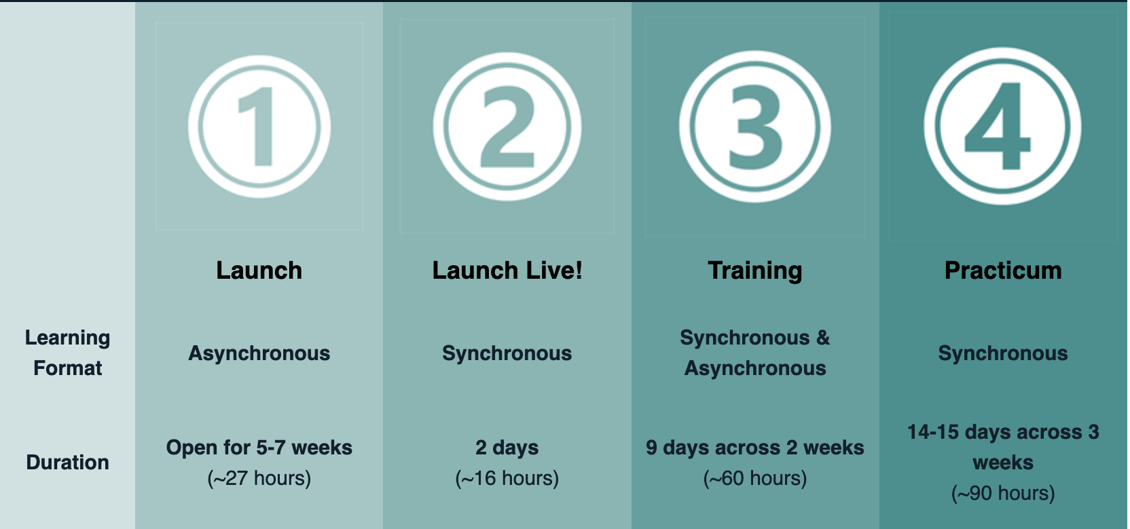
Corps Member Experience
Overview of Training
Teachers will receive ~100 hours of development prior to working with students.
“Practicum” is where teachers will apply their learning to their student teaching.
Dates
June 8-22
June 23-July 14th

Slide 12
Corps Member Experience
Key areas of development
RELATIONSHIPS
Rigorous Instruction I can adjust and implement a rigorous curriculum based on my evolving vision for student learning and instructional design anchored in Culturally Relevant Pedagogy (CRP), incorporating Universal Design for Learning (UDL).
I can prepare instruction that is aligned to grade-level standards and rigorous expectations | I have a clear vision of what equitable & inclusive grade-level content (student knowledge & skills) looks like and can identify instructional materials that meet that bar I have a clear understanding of the purpose behind a core set of grade-level and content-specific instructional approaches and strategies I can adjust lesson-level instructional materials to ensure they reflect my understanding of our core frameworks (CRP, SEL, and UDL) so they meet the bar for rigorous and relevant instruction
I can lead instruction that is aligned to grade-level standards and rigorous expectations | I articulate the daily learning goal(s) and understand how the grade-level and content-specific instructional activities align to the goal(s) I implement a core set of grade-level and content-specific instructional approaches and strategies I execute the lesson I prepared with fidelity

Slide 13
Corps Member Experience
Key areas of development
RELATIONSHIPS
Learning Environment I develop a vision and aligned practices for co-creating an equitable and inclusive learning environment informed by my knowledge of the science of learning and development (inclusive of child development, trauma-informed practices, and social-emotional learning).
I have a clear vision for my summer learning environment because I have created and/or internalized a summer learning environment plan | I have created a plan for building relationships with students and reflect on the alignment of my actions to that plan I know, teach, and reinforce my classroom norms, expectations, and procedures I identify ways I will celebrate students and determine the actions/habits that will lead students to achieve social, emotional, and academic development
I execute and reflect on my learning environment plan | I invest in learning about my students and school community and incorporate my learning into my practice in a way that reflects students’ culture, backgrounds, and interests I incorporate attention signals and monitor their effectiveness to ensure student access to content I consistently give student-centered directions and follow up on them to increase meaningful engagement I incorporate various strategies from my toolkit to sustain student engagement and consistently respond to unengaged learners to support all students I celebrate students in meaningful ways providing sincere and authentic praise to illuminate student growth and success

Slide 14
Corps Member Experience
Key areas of development
RELATIONSHIPS
Relationships I have begun to work with diverse individuals and groups of people toward a vision that strengthens student outcomes.
I invest in learning about my students and school community and incorporate my learning into my practice in a way that reflects students’ culture, backgrounds, and interests I build meaningful relationships with my TFA colleagues by engaging in critical conversations and remain open to give and receive feedback I reflect on the relationships I’ve built over the summer and how I have incorporated diverse perspectives to inform my practice

Slide 15
TFA’s Support of Corps Members
Summer staff dedicated to development and performance of teachers to have positive impact on student learning
School Site Director:
Drive culture of growth and development across school community
Monitoring CMs impact on students
NSSI curriculum facilitation
Teacher Coach x2:
Rapid growth and improvement of instruction, learning environment and relationships with students and colleagues
Charged to partner with mentor to individualize support of teacher
Operation Specialist:
Supports logistic and operations for school site
Ensures teachers have all logistics on school site to successfully deliver instruction and engage with their development
Supports a culture of collaboration (work room, spaces for meetings/collaboration)

Slide 16
Mentors Support of Corps Members
Supporting teachers to facilitate rigorous instruction
By June 16th, receive reference guide to support your ability to mentor teachers:
Provide you with curriculum material and overview of standards (NSSI for all subjects besides science) to better offer feedback and support holding teachers accountable to delivering high quality instruction
Assigned mentees and relevant information to understand their development and how you can best support
Project based learning opportunities
Meet your teachers Friday, June 23rd, in the AM!

