Slide 1
Student Experience
Essential Question for students throughout experiences:
How is what I am learning relevant to me now and informing my future?
Summer Academy is relevant and useful to students futures
Core academics
Project-based Learning
Field trip
Showcase

Slide 2
Field Trip Objectives
July 7th
Students in Payette have meaningful opportunities that shape their perspectives on what it means to have a future of their choice and life full of possibilities
Student agreeance to the relevance of Summer Academy to their futures, excitement for their futures, and the opportunity to explore careers
Notes:
Additional information

Slide 3
 | Overview |  | High School | Middle School
7:30-7:45 | AM Huddle 7:30-8:00a |  | Prepare for student groups | Prepare for student groups
7:45-8:00 |  |  | Students Groups by Bus @7:55 | Students Groups by Bus @7:55
8:00-8:15 | Travel to CWI Nampa 8:00-8:45 |  | Travel to CWI Nampa 8:00-8:45 | Travel to CWI Nampa 8:00-8:45
8:15-8:30
8:30-8:45
8:45-9:00 | CWI 8:45a-11:00a |  | Settle-in @ CWI | Settle-in @ CWI
9:00-9:15 |  |  | CWI Admissions 9:00-9:45 | CWI Tour Micron Building 9:00-9:45
9:15-9:30
9:30-9:45
9:45-10:00 |  |  | Break | Break
10:00-10:15 |  |  | CWI Tour 10:00-10:45 | Student Activity 10:00-10:45
10:15-10:30
10:30-10:45
10:45-11:00 |  |  | Student Reflection 10:45-11:00 | Student Reflection 10:45-11:00
 | Overview |  | High School | Middle School
11:00-11:15 | Travel to Amano 11:00-11:30 |  | Travel to Amano 11:00-11:30 | Travel to Amano 11:00-11:30
11:15-11:30
11:30-11:45 | Indian Creek Plaza 11:30-12:45p |  | Amano Spotlight 11:30-12:00 | Explore Indian Creek Plaza 11:30-12:00
11:45-12:00
12:00-12:15 |  |  | Switch | Switch
12:15-12:30 |  |  | Explore Indian Creek Plaza + Lunch 12:15-12:45 | Amano Spotlight 12:15-12:45
12:30-12:45
12:45-1:00 | Student Closeout 12:45-1:00p |  | Student Closeout 12:45-1:00p | Student Closeout 12:45-1:00p
1:00-1:15 | Travel to Payette HS 1:00-2:00p |  | Travel to Payette HS 1:00-2:00p | Travel to Payette HS 1:00-2:00p
1:15-1:30
1:30-1:45
1:45-2:00
2:00-2:15 | Dismissal |  | Dismissal | Dismissal
Notes:
Detailed Schedule

Slide 4
Field Trip Engagement
Pre, During, and Post
Pre-engagement (Thurs, 7/6, ~30 mins, during mid-block time):
Ground students in essential question and connection to experiences
Activate students thinking about their futures
Prepare for field trip and expectations
During Engagement:
Small group to reflect and make-meaning in small groups
Post-engagement:
Assess student experience
Students can showcase their learning at Summer Academy and application to possible futures
Notes:
Additional information

Slide 5
Summer School Field Trip
Notes:
Starting Slide for students

Slide 6
What are we up to at summer school:
All parts of summer school should feel helpful to your futures!
Core classes in the morning
Project-based learning in the afternoon
Field trip on Friday to explore your futures
Student Showcase on our last day, Thursday @11:30am to showcase what you’ve learned
Notes:
Overview of what we are doing at summer school

Slide 7
How is what I am learning now going to be helpful in my future?
Notes:
Question that we want to answer by the end of the field trip

Slide 8
What are your dreams for your future? Are they possible?
Notes:
5 minute Activity: Four corners, Turn and talks, etc

Slide 9
Reflection Worksheet
Take 5 minutes to quietly answer questions 1-4 on the worksheet
How has summer school been helpful for your future?
What are your dreams for your future? Are they possible?
What are you good at? What are your interests and hobbies?
Can any of those turn into a job or career?
Notes:
Set a 5 minute timer to reflect and answer questions on the worksheet

Slide 10
When is the field trip?
This Friday, July 7th
We will be going to the College of Western Idaho in Nampa and Amano in Caldwell.
We will be taking a bus to go from place to place.
Notes:
Field Trip Information

Slide 11
What do you need to bring?
All students need to wear Payette school colors (red and black).
Wear clothes and shoes you are comfortable walking in
Bring a water bottle if you can!!
Teachers will have any other supplies you will need.
Notes:
Field Trip Information

Slide 12
Procedures
We will stay in our assigned small groups during the field trip.
Always be able to see your teacher
Let your teacher know if you have to go to the bathroom
Notes:
Field Trip Information, feel free to edit or add your own!

Slide 13
Consequences
Always Safe
Respectable
Responsible
Resilient
Notes:
Field Trip Information, feel free to edit or add your own!

Slide 14
Schedule
8:00 | Leave Payette High School
8:45 - 11:00 | College of Western Idaho - Nampa
11:30 - 1:00 | Indian Creek Plaza and Amano - Caldwell Lunch from 12:15 - 12:45 (boxed lunch from Amano)
2:00 | Arrive back at Payette High School
Notes:
Simple Schedule Overview

Slide 15
8th Grade ONLY!
Choose your experience!
OPTION 1: (H)
Why a community college and what does College of Western Idaho have to offer?
OPTION 2: (M)
What can my future look like? Discussions and activities about your possible future.
Notes:
For 8th graders only, students will be able to pick which route they want to take for the beginning portion of the field trip. This will affect the groups. New groups should be made by Thursday afternoon before you leave and tell Tara!

Slide 16
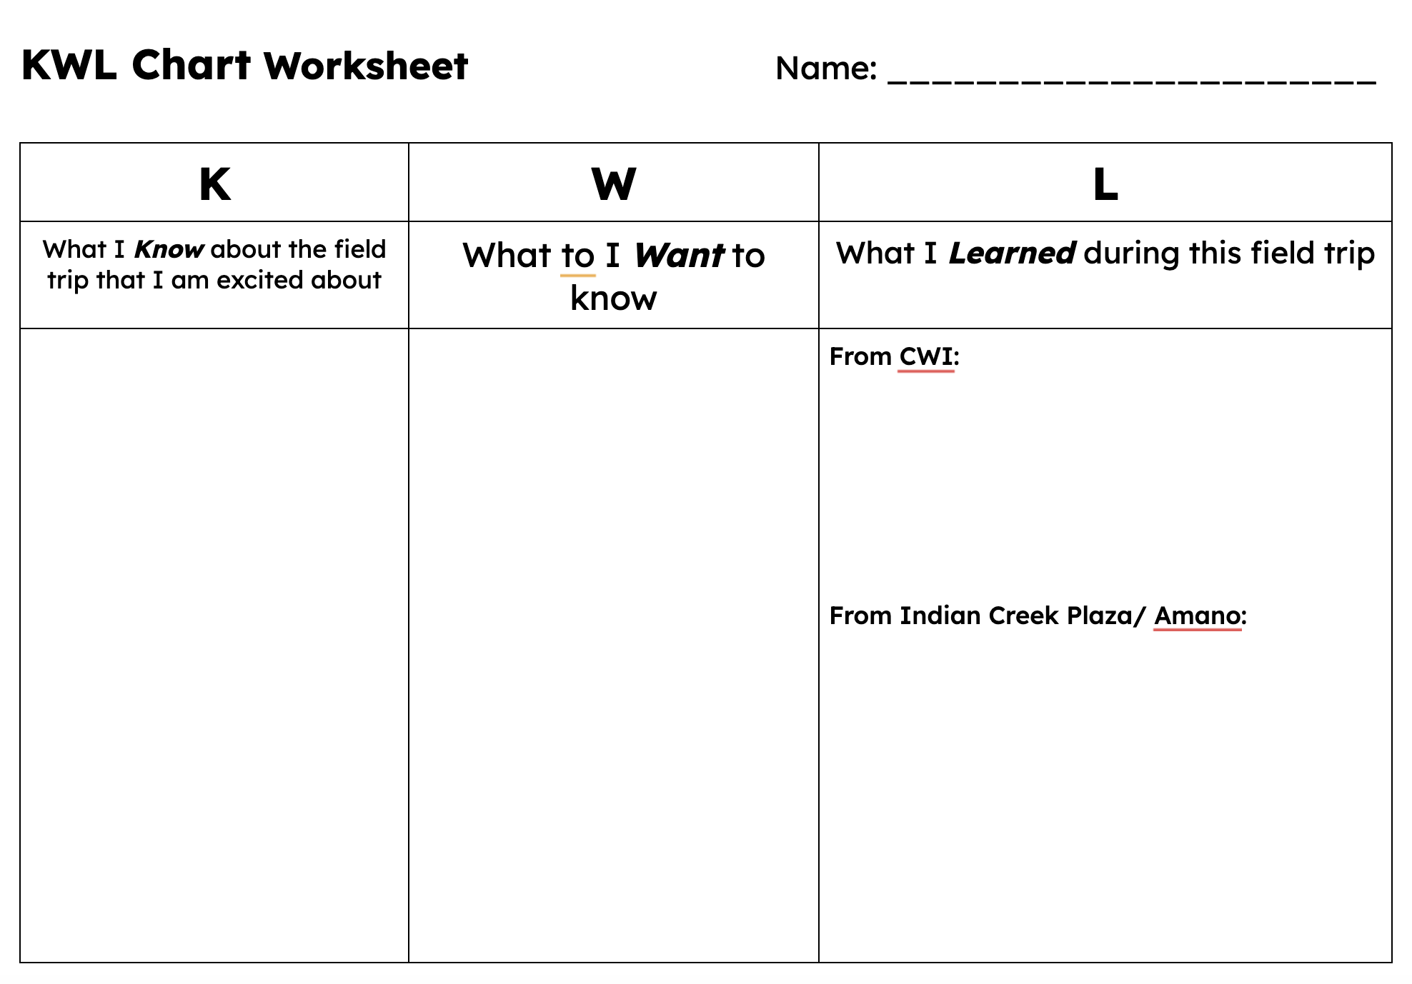
KWL Chart
Take 3 minutes to fill in the Know and Want to Know sections of the worksheet
Notes:
Set a 3 minute timer to reflect and answer questions on the worksheet

Slide 17
Groups - 5th grade
Look for your name on the chart!

Slide 18
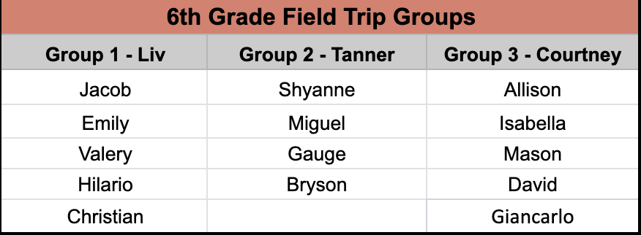
Groups - 6th grade
Look for your name on the chart!

Slide 19
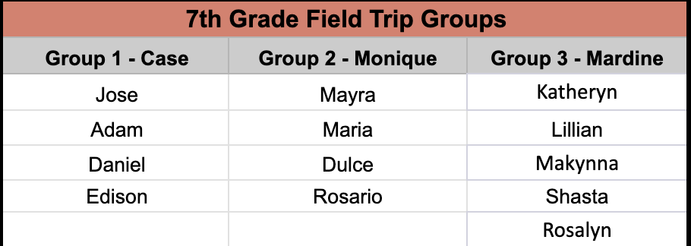
Groups - 7th grade
Look for your name on the chart!

Slide 20
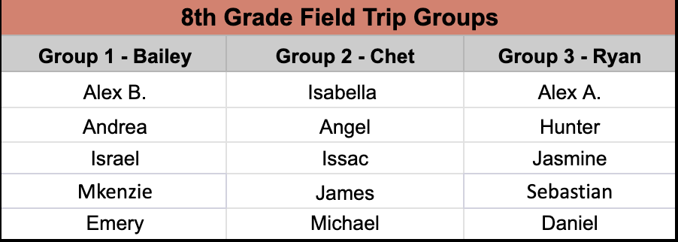
Groups - 8th grade
Look for your name on the chart!
TBD
Notes:
Groups will change based on what option they pick. This will also affect what bus they get on.

Slide 21
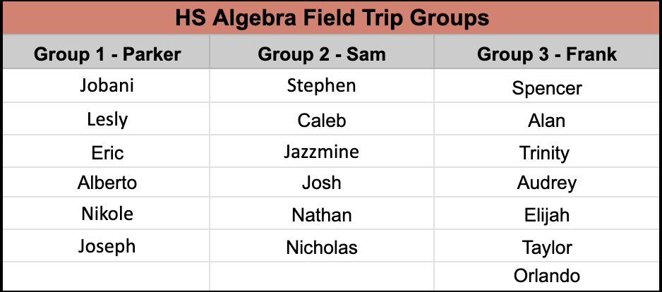
Groups - HS Algebra
Look for your name on the chart!

Slide 22
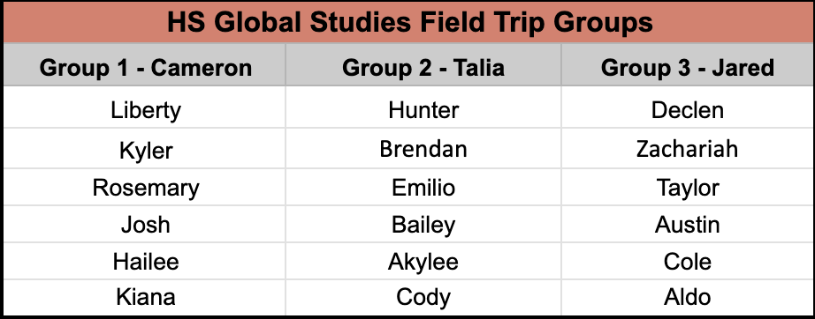
Groups - HS Global Studies
Look for your name on the chart!

Slide 23
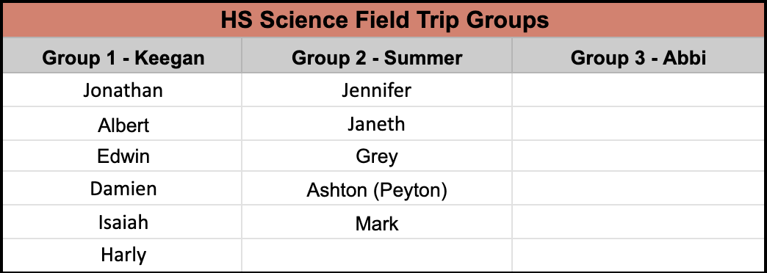
Groups - HS Science
Look for your name on the chart!

